Slide 1
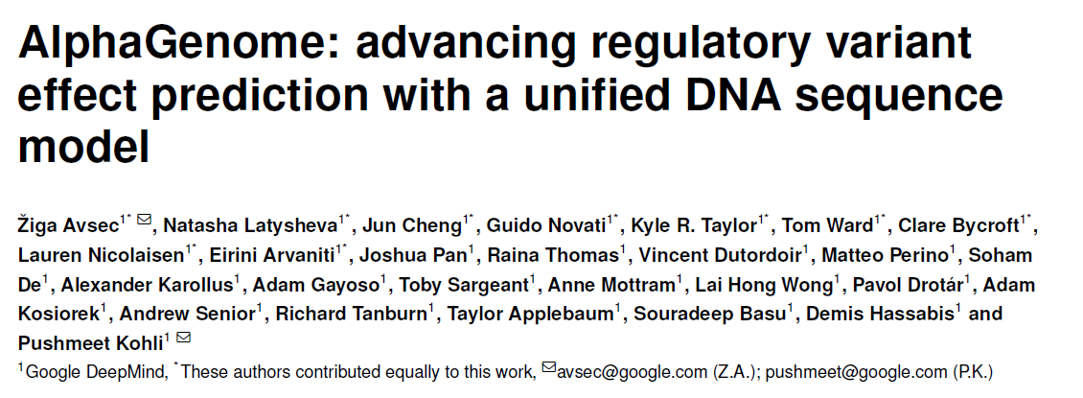
JC 7/11/2025
Wendao

Slide 2
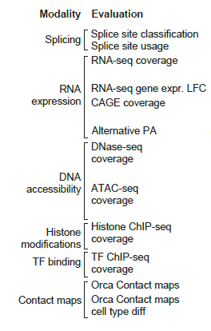
Predicting genome tracks from DNA sequence
Data modalities:
Gene expression (RNA-seq, CAGE-seq [TSS], PRO-seq [nascent RNA])
Splicing
DNA accessibility (ATAC-seq, DNase-seq)
Histone modification (ChIP-seq)
Transcription factor binding (ChIP-seq)
Chromatin conformation (Hi-C)
Predicting molecular effect of variants

Slide 3
Limitations of current models
Trade-off between context length and resolution
Short-range models: base-resolution limited to short sequence
Long-range models: broad context with reduce resolution (>32bp)
Diverse modalities versus specializing
cannot handle cross-modality variant effects or integrate diverse regulatory outcomes
AlphaGenome, a model that unifies multimodal prediction, long sequence context, and base-pair resolution into a single framework

Slide 4
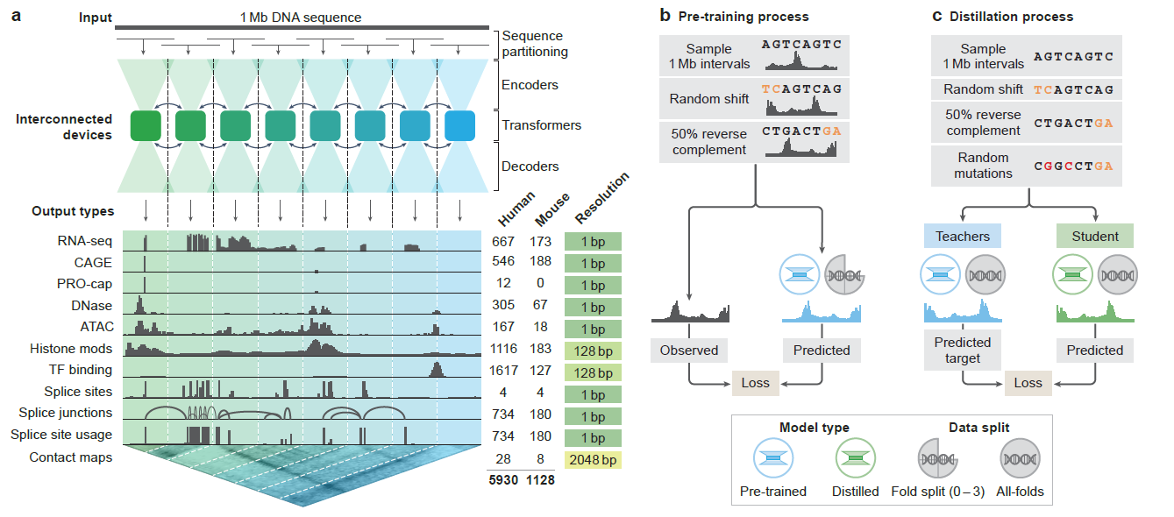
Model design
Architecture and training will be introduced by Gang
Pretrained full model and distilled model
Data from different tissue/cell type/ChIP-seq target/etc

Slide 5
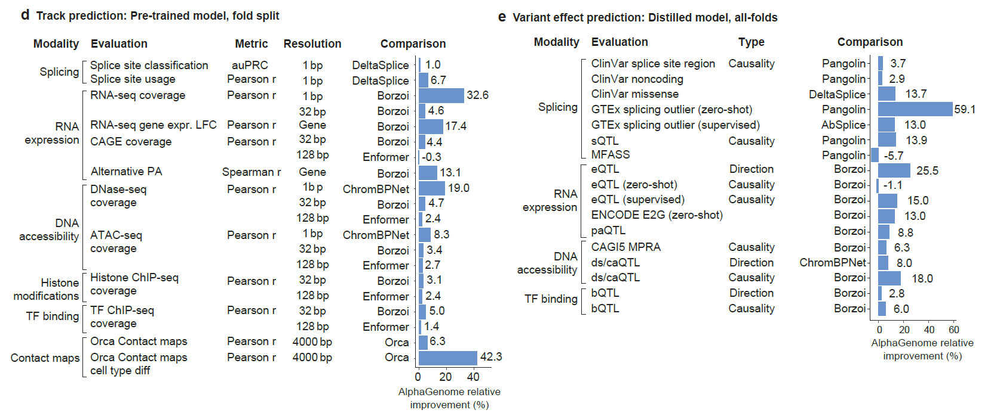
Evaluation and benchmarking
Outperform external models in 22/24 tasks

Slide 6
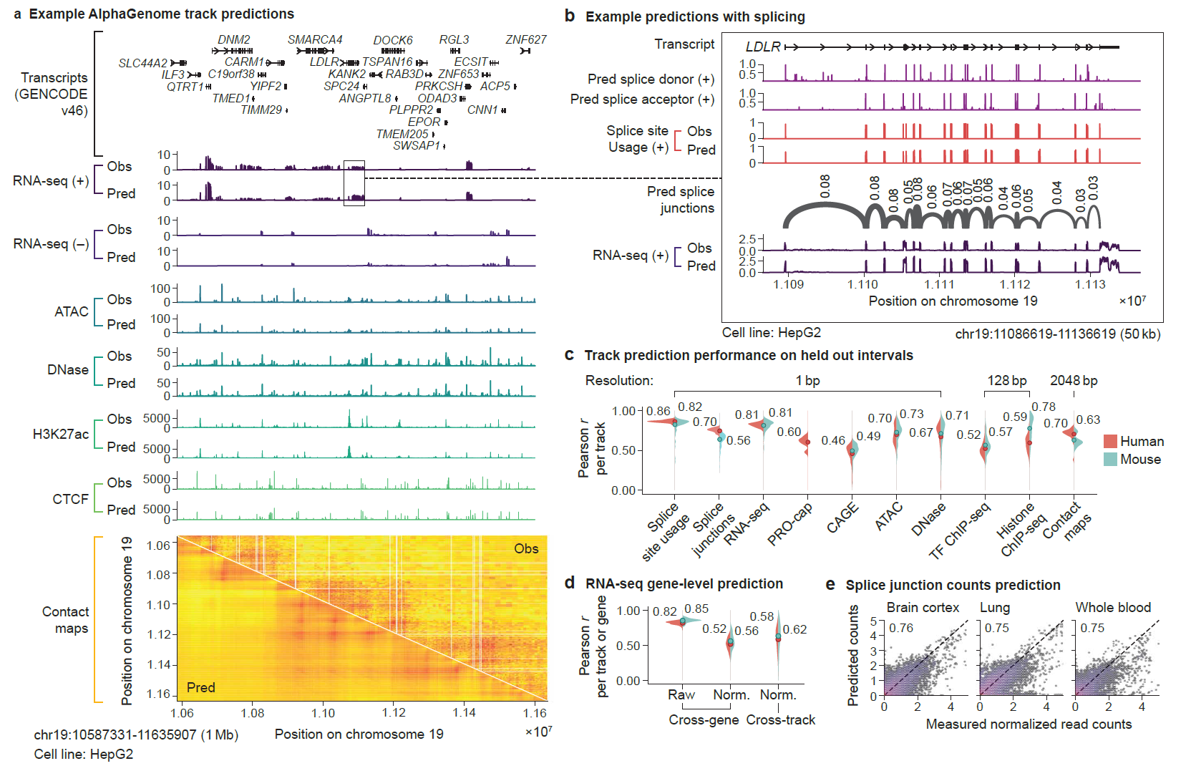
Example of cross-modality prediction
Topologically associating domain
TAD

Slide 7
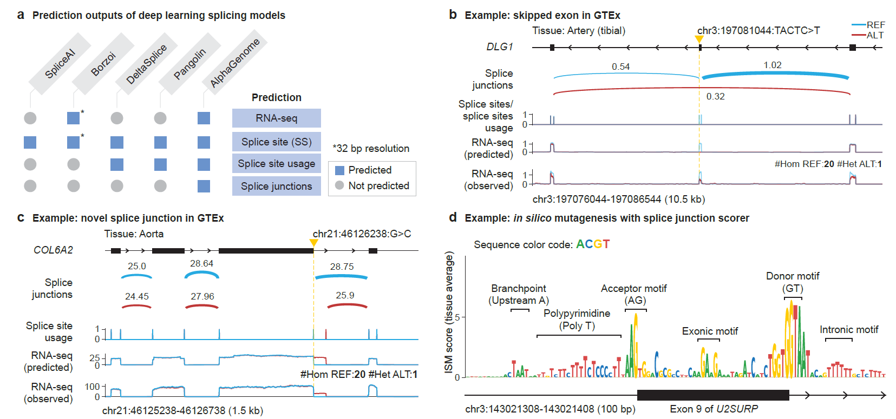
Splicing variant prediction
Exon skipping, novel splice junction
In silicon mutagenesis: mutation each nt for splicing prediction
SS: donor/receiver site or not
SSU: ratio of reads using the SS to reads using or excluding the SS
SJ: count of junction reads
Score = ALT – REF for SJ

Slide 8
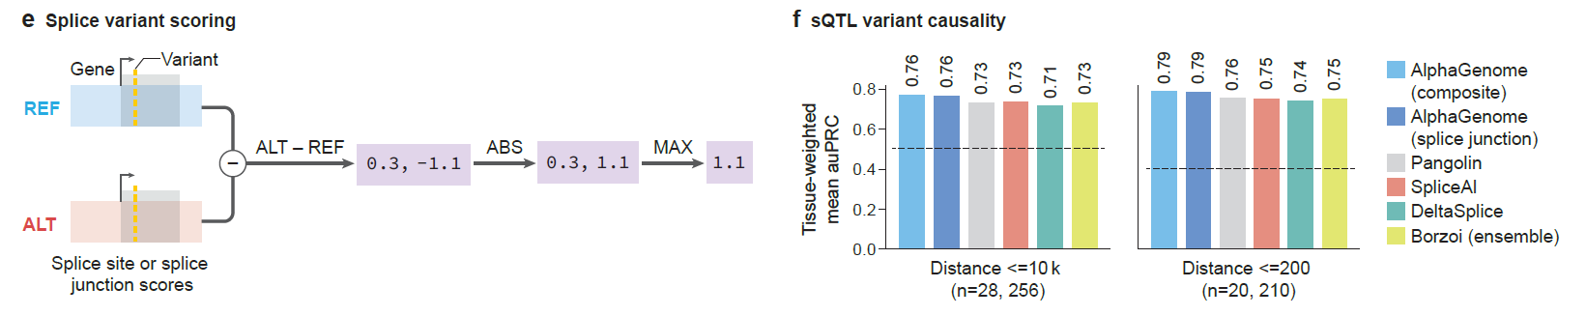
Composite score of splicing variant effect
Score based on SS, SSU, SJ, measuring the effect of SNP on splicing
Benchmarked using sQTL (variants affecting splicing) classification
SS: donor/receiver site or not
SSU: ratio of reads using the SS in reads using or excluding the SS
SJ: count of junction reads

Slide 9
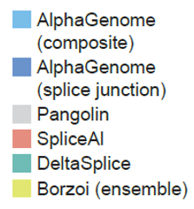
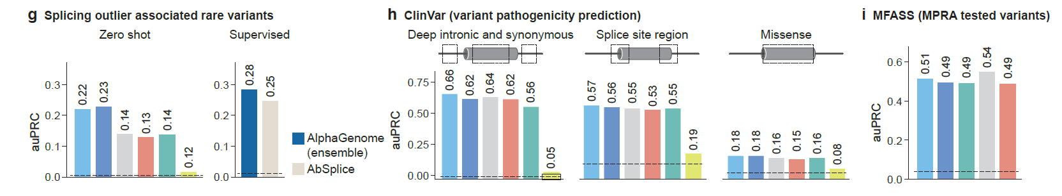
Composite score of splicing variant effect
Predicting rare variants in GTEx splicing outlier
Predicting ClinVar pathogenic variants
Predicting data from splicing minigene reporter assay
MFASS: synthetic biology approach to measure the splicing outcomes of thousands of sequence variants in parallel

Slide 10
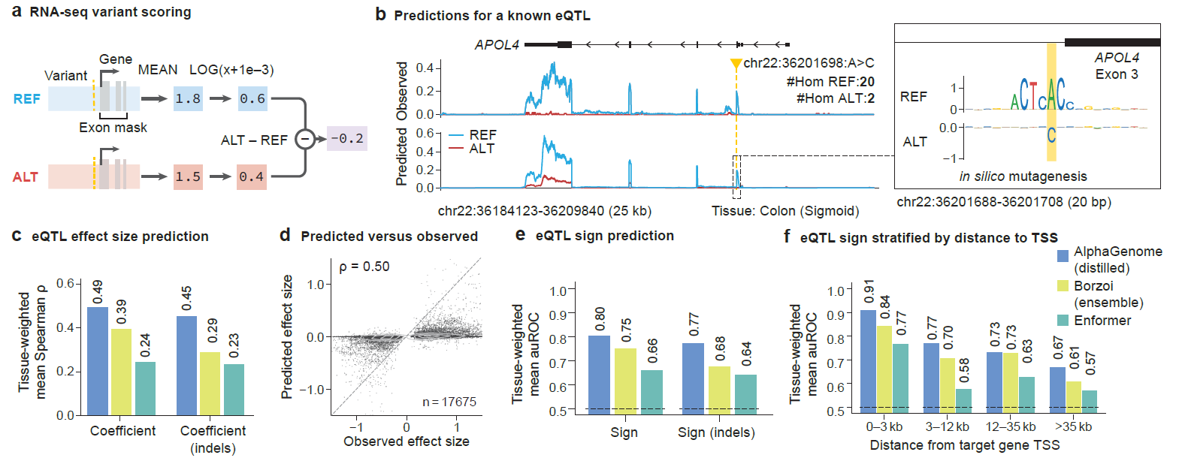
eQTL prediction
Predict eQTL, RNA expression
eQTL effect size (magnitude and direction of regulation), sign (upregulate or downregulate expression)
Benchmark with Borzoi and Enformer
ISM score:
>0: increase expression
<0: decrease expression

Slide 11
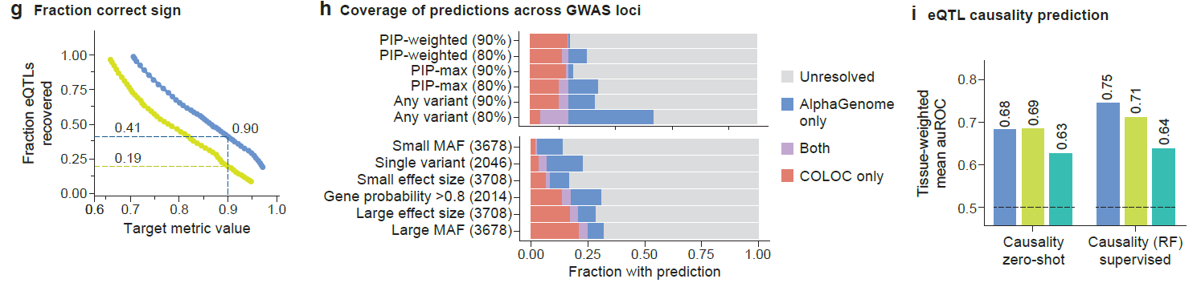


eQTL and GWAS prediction
Recover more GTEx eQTL at 90% correct sign prediction
Predict GWAS loci that are not found by colocalization (COLOC)
Better distinguishing eQTLs from controls (distance-matched variants)
RF using scores from multiple modalities

Slide 12
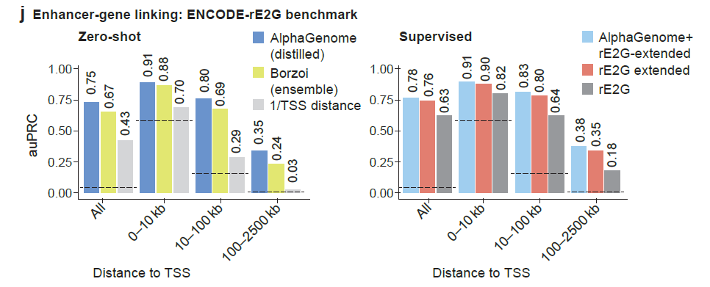
Enhancer-gene relation prediction
CRISPRi perturbation dataset from the ENCODE-rE2G study
rE2G: ENCODE model to predict enhancer–gene links
rE2G extended: improved model

Slide 13
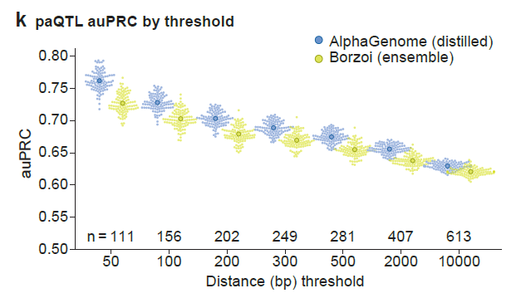
paQTL prediction
paQTL: variants affecting alternative polyadenylation

Slide 14
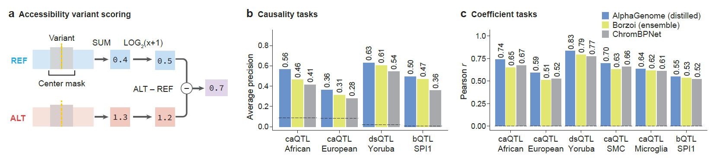
Chromatin accessibility and TF binding prediction
caQTL: variants affecting chromatin accessibility
dsQTL: variants affecting DNase sensitivity
bQTL: variants affecting TF binding

Slide 15
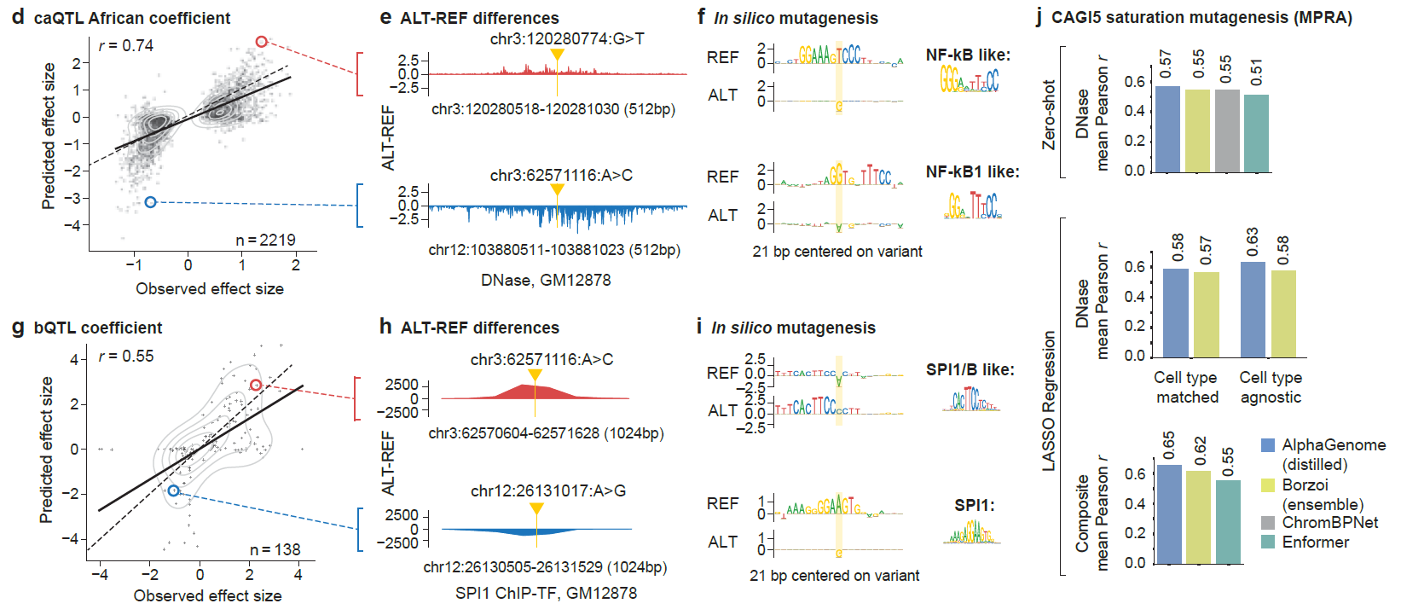
Chromatin accessibility and TF binding prediction
Evaluation and examples for TF binding
CAGI5: Critical Assessment of Genome Interpretation (2018-2019),
predicting the regulatory effects of non-coding genetic variants using saturation mutagenesis

Slide 16
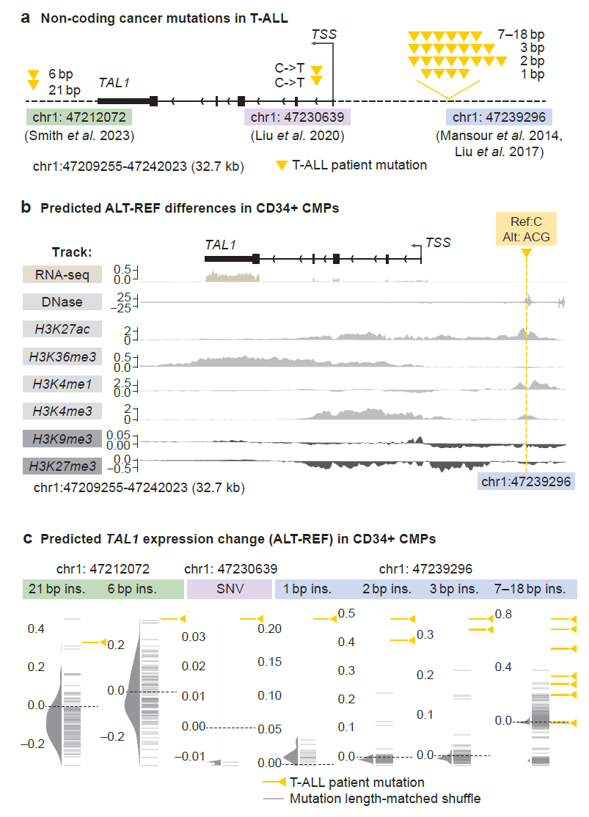
Multimodal analysis
Application in T-cell acute lymphoblastic leukemia (T-ALL)
Three known sites to increase oncogene TAL1 expression
AlphaGenome predicts increased expression with other track information

Slide 17
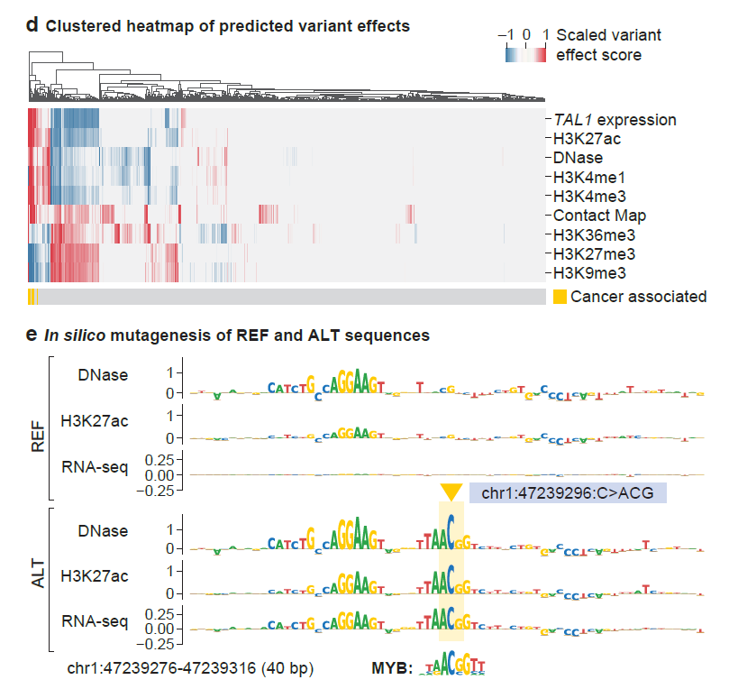
Multimodal analysis
Oncogenic variants (yellow) have distinct regulatory mechanism compared to controls (gray)
An insertion introduce a MYB (TF) motif that increase chromatin accessibility, enhancer mark and TAL1 expression
Active enhancer
Active enhancer
Active promoter
Active transcription
Silenced genes
Heterochromatin, silencing

Slide 18
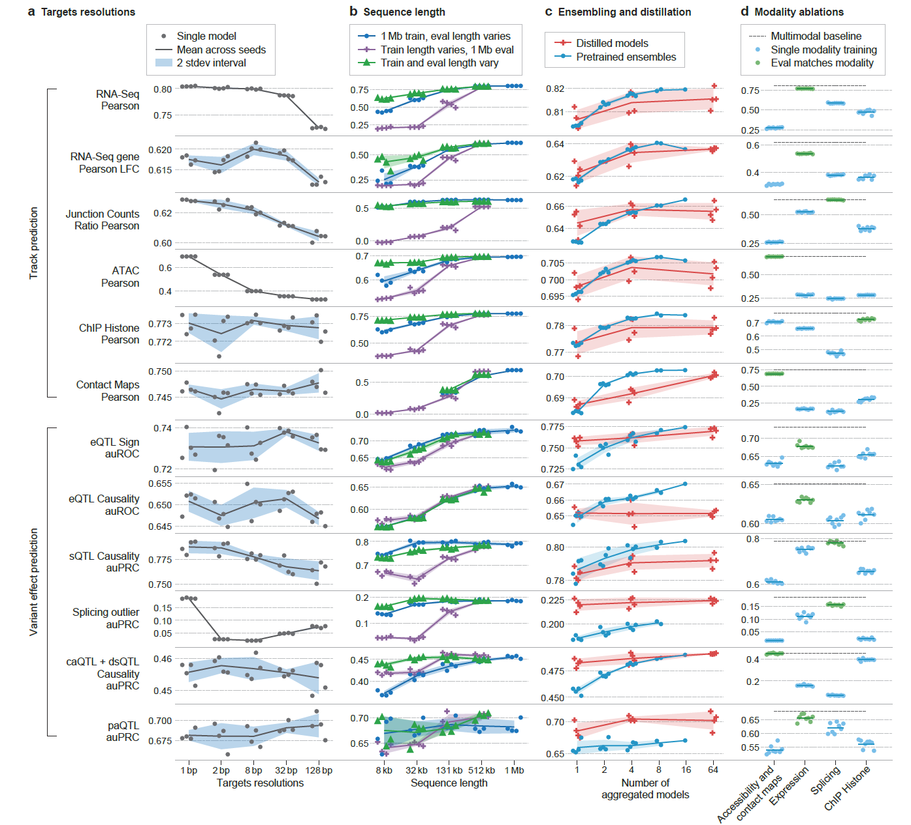
Model and data ablations

Slide 19
Model and data ablation result summary
Target Resolution
Training with 1 bp resolution targets gave the best performance, especially for fine-resolution tasks
Variant effect predictions aggregated over larger regions (like exons or gene bodies) were robust to resolution
Training and Inference Sequence Length
Training on 1 Mb sequences and using the full 1 Mb context at inference yielded optimal results
Distillation vs. Ensembling
Distillation is competitive with or better than traditional ensembles
Multimodal Learning
Fully multimodal models outperformed single-modality models overall

Slide 20
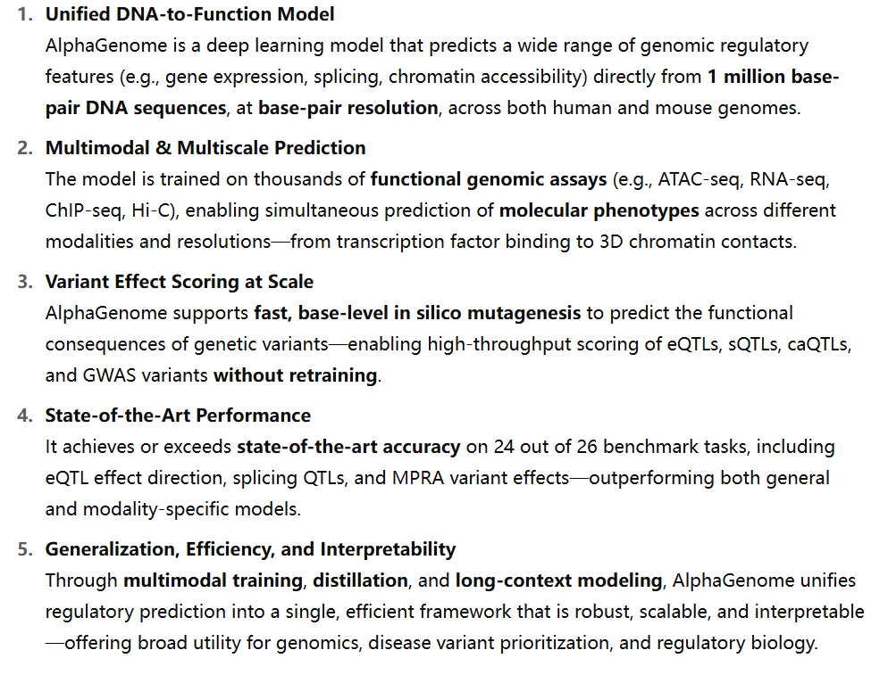
Summary

Slide 21
Limitations
Challenging to capture distal regulatory elements (>100 kb)
Tissue- or condition-specific prediction
Species coverage is only limited to human and mouse
Unlike Evo2 trained on > 10k organism genomes
Personal genome prediction
Traits analysis beyond variant-to-function scope

